Slide 1
Title
Name - | Suhel Kumar Gupta
USN - | 241DD01340
Elective - | Computer Science and IT
Title of the Project - | Personal Desktop Assistant with Voice Recognition and Smart Features

Slide 2
Introduction
Digital assistants transform how users interact with technology through voice and natural language.
Existing systems (Google Assistant, Siri, Alexa, Cortana) are consumer-focused with limited desktop integration.
Challenges:
Fragmented workflows across multiple apps.
Lack of academic extensibility in proprietary systems.
The proposed Optima Assistant is a Python-based, modular, and extensible prototype designed for academic research and real-world productivity.
Key advanced features:
Face recognition authentication for secure login.
Email and WhatsApp automation for communication tasks.
PC control via hand gestures using MediaPipe + PyAutoGUI.

Slide 3
Objectives
Develop a secure assistant with face recognition authentication for user login.
Enable voice-controlled productivity by integrating reminders, recommendation, note, todos, news, and Wikipedia and google searchs.
Automate communication tasks through email and WhatsApp integration.
Provide system-level control with features like file management, system monitoring, and PDF reading.
Introduce gesture-based PC control using MediaPipe + PyAutoGUI for mouse movements and clicks.
Design a modular, extensible architecture that allows future academic and research enhancements.
Provide intelligent recommendations using a built-in recommendation engine (music, study materials, websites).
Enhance user interaction with chatbot mode for general queries and small talk.
Design a modular, extensible architecture that allows future academic and research enhancements.

Slide 4
Research Methodology
Approach
Follows software engineering principles with modular design.
Each feature (voice recognition, task manager, AI modules) developed and tested independently.
Development Tools
Python as core language.
Libraries: SpeechRecognition, Pyttsx3, OpenCV, MediaPipe, PyAutoGUI.
APIs: Weather, News, Email, WhatsApp integration.
Architecture Focus
System Architecture Diagram highlights 4 layers: Presentation, Application, Service, Infrastructure.
Secure data flow with authentication boundaries.

Slide 5
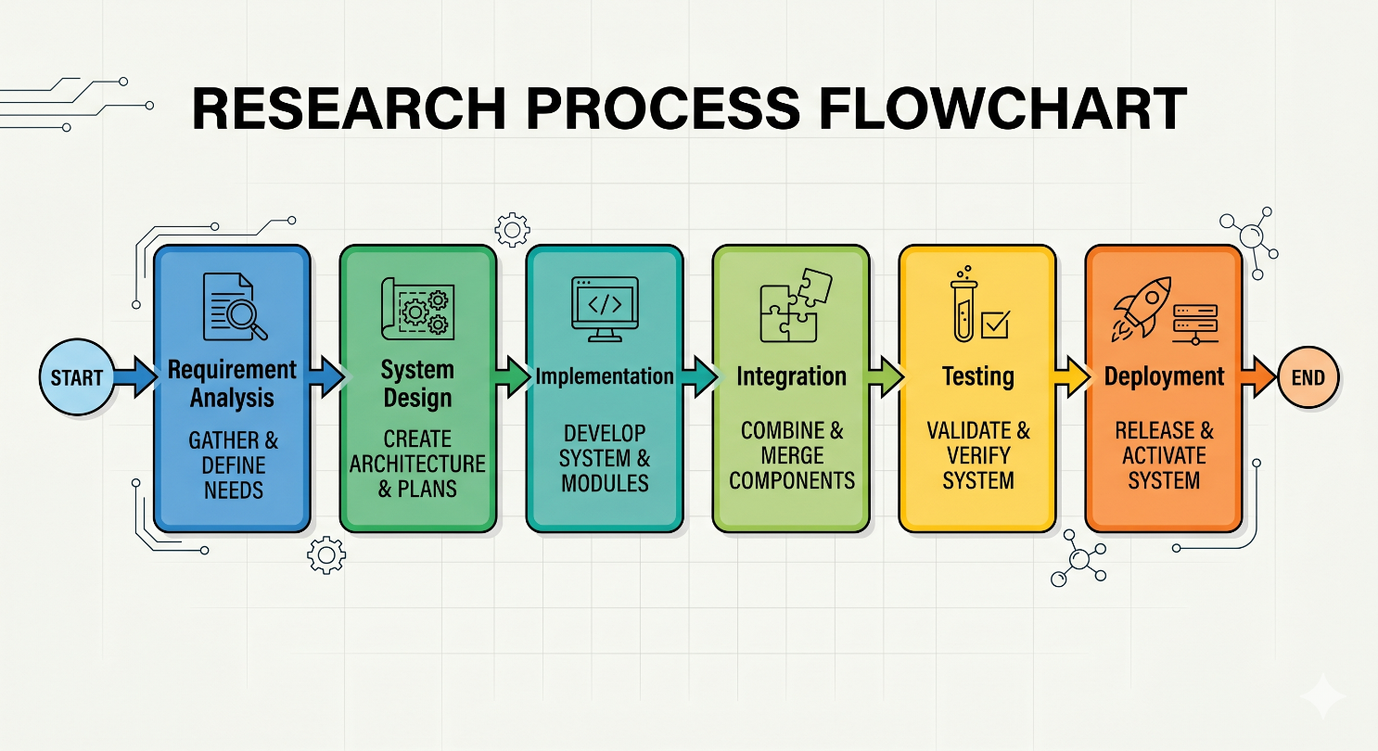
Research Methodology

Slide 6
System Architecture
Presentation Layer
Chat window (voice + text input).
User interface for reminders, alarms, and notifications.
Application Layer
Core logic for command processing.
Modules: Voice recognition, chatbot, gesture control, authentication.
Service Layer
API integrations: Weather, News, Email, WhatsApp, Wikipedia.
Recommendation engine for personalized suggestions.
Infrastructure Layer
Data storage: reminders, birthdays, face models.
Security boundary for authentication and external services.

Slide 7
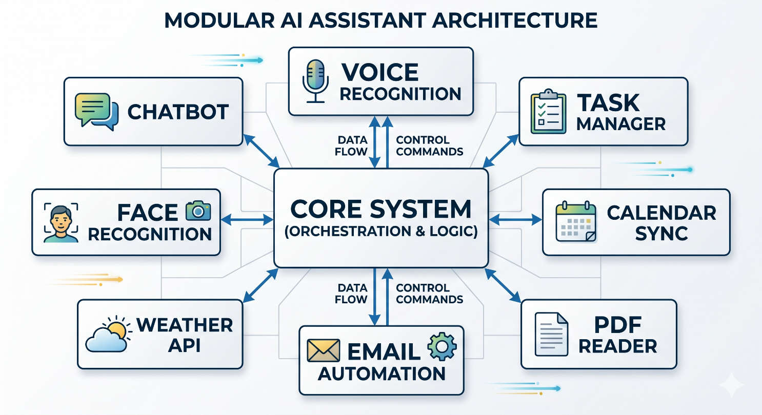
SYSTEM ARCHITECTURE

Slide 8
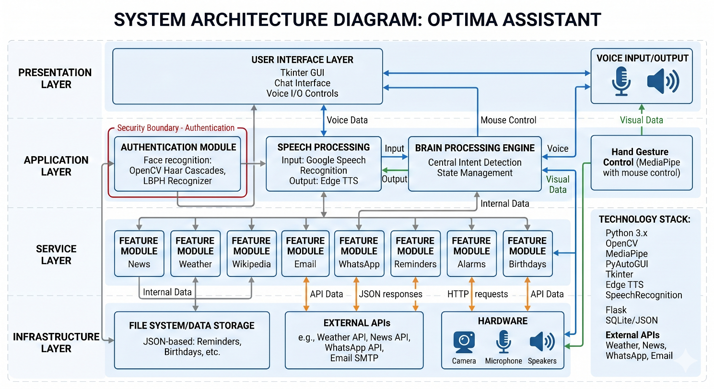
ARCHITECTURE DIAGRAM

Slide 9
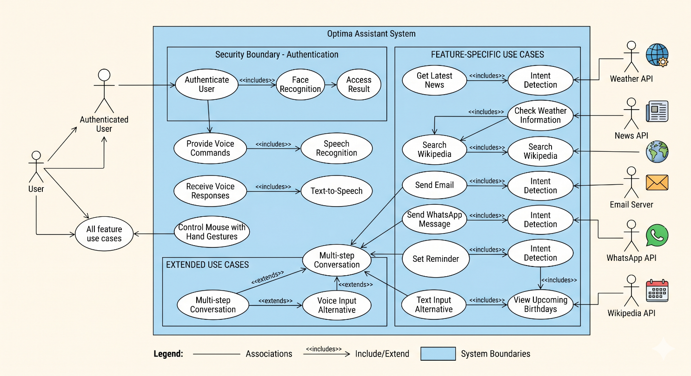
UML Use Case Diagram

Slide 10
Data Analysis & Interpretation
Observation-based analysis during sanity testing and user interaction.
Performance analysis using task completion time, latency, and error-handling metrics.
Comparative analysis between manual tracking and automated tracking.
Platform-wise analysis for LinkedIn, Indeed, and other job portals.
Database and backend analysis for response time, scalability, and consistency.

Slide 11
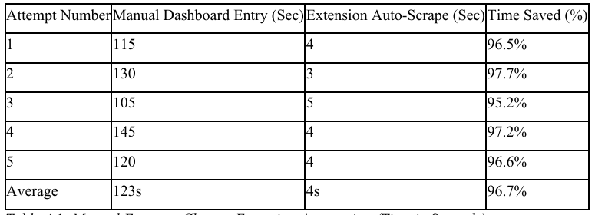
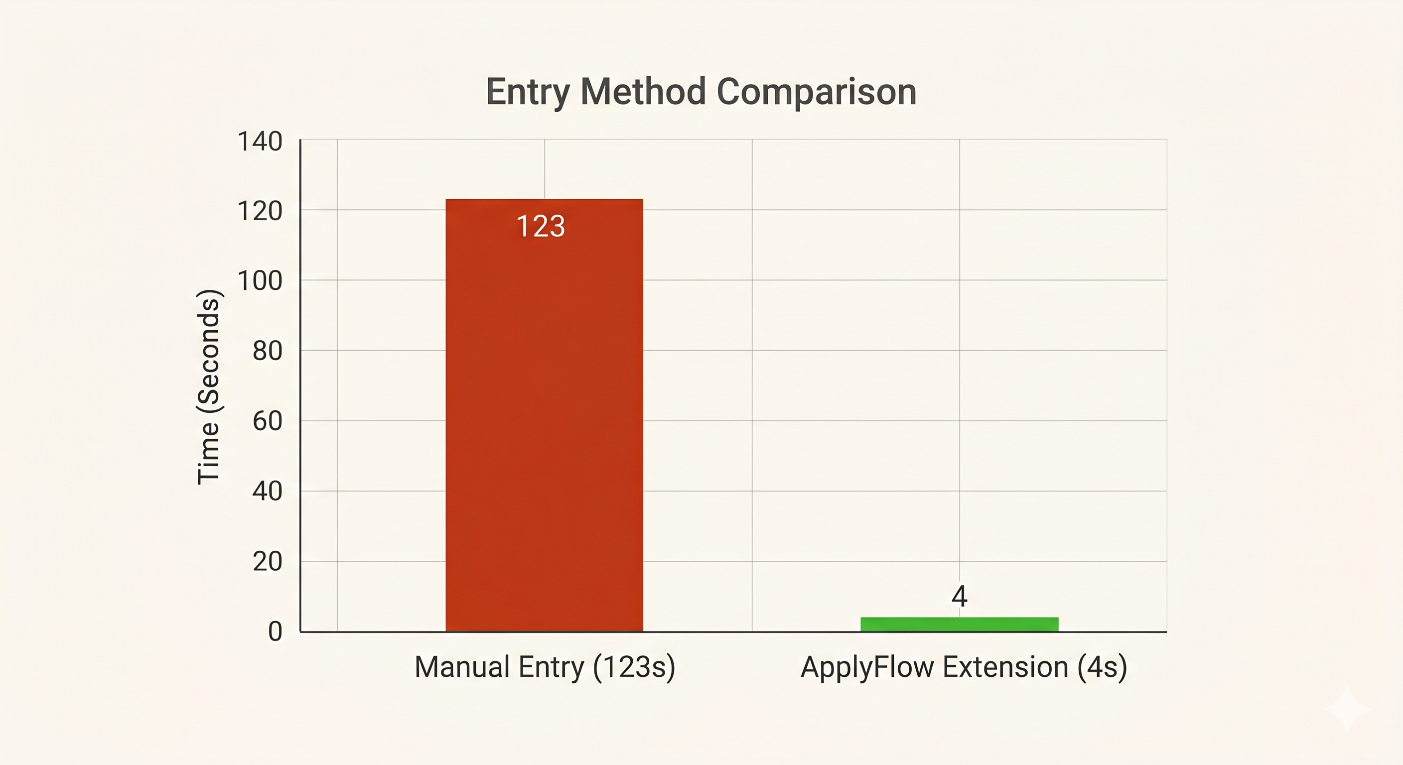
Analysis in Table and Graphs
Comparative Analysis of Data Entry Efficiency
Comparative Analysis of Entry Speed

Slide 12
Advantages
Saves significant time compared to manual tracking.
Improves data-entry accuracy through auto-fill.
Provides real-time synchronization between extension and dashboard.
Keeps the UI stable on third-party websites using Shadow DOM.
Offers better organization and follow-up visibility for job seekers.
Supports structured, data-driven job-search management.

Slide 13
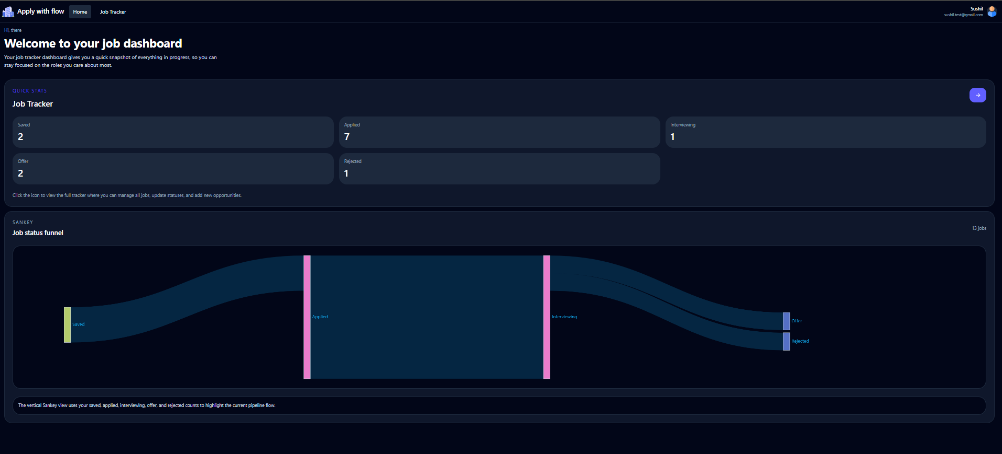
Dashboard analytics

Slide 14
Risks / Limitations
Dynamic AJAX-based websites may delay or block scraping.
Salary extraction may fail when salary is shown as images or icons.
Extension visibility can vary on unusual page layouts.
Browser compatibility is currently focused mainly on Chrome.
Manifest V3 introduces more complex service-worker handling.
Very slow networks may delay cloud sync if local caching is not used.

Slide 15
Findings and Suggestions
Automation reduced tracking time significantly.
Structured platforms like LinkedIn gave the highest extraction success.
Real-time dashboard updates improved perceived performance.
Users preferred one-click save and auto-fill features.
Future improvements include IndexedDB caching, NLP summaries, follow-up reminders, and cross-browser support.

Slide 16
Hosted Application Details
Component | Details
Project Status | Live and Hosted
UI Hosted URL | https://job-tracker-app-kohl-six.vercel.app/login
Backend Hosted URL | https://smart-job-tracker-api-w44d.onrender.com/api-docs/#/
Chrome Extension | Job Tracker Pro

Slide 17
Conclusion
The Smart Job Application Tracker successfully transforms a manual, chaotic process into an organized workflow.
The integration of Angular 18, Node.js, Supabase/PostgreSQL, and Chrome Extension automation proved effective.
The project demonstrates that automation improves efficiency, reduces error, and supports better decision-making for job seekers.
With further AI and browser-support enhancements, the system has strong potential for future growth.

Slide 18
Thank you

